Slide 1
MOBILE SALES DATA ANALYSIS
-2025
PROJECT PRESENTATION

Slide 2
DESCRIPTION ABOUT DATA
Mobile industry is rapidly growing.
This project analyzes sales data to understand brand performance, revenue trends, and customer behavior.

Slide 3
REVENUE ANALYSIS
Calculated total revenue, average revenue, and maximum revenue
Helps evaluate business performance
Total revenue 4639641
Average revenue 9279.282
And the maximum revenue 29660

Slide 4
PAYMENT METHOD
The total transaction counts for each payment method are as follows:
Credit Card: 969384 transactions
Cash: 995141 transactions
Debit Card: 929376 transactions
Bank Transfer: 876926 transactions

Slide 5
PROCESS
First we checked the information about the dataset , regarding their feature , datatype and null values
Check the unique features
Checked the duplicated for the features
Group by the data and calculate the sales and visualize the data

Slide 6
WORKFLOW OF DATA ANALYSIS
COLLECTION OF DATA
UNDERSTANDING DATA AND BUSINESS PROBLEM
DATA CLEANING
DATA TRANSFORMATON
DATA VISUALIZATION
PRESENT FINAL INSIGHTS

Slide 7
1.COLLECTION OF DATA
This data collected from Kaggle and checking their rows and columns , null values.
Downloaded in CSV format.
2.UNDERSTANDING DATA AND BUSINESS PROBLEM
The dataset includes customers personal details like customer id,country
it contains product details like brand name ,model ,storage ,color,price_usd,revenue_usd,sale month,sale year.
Payment details like payment method.

Slide 8
3.DATA CLEANING
Checked missing values using data.isnull().sum()
Checked duplicate Sale_ID
Dataset found clean and ready for analysis
Checked rows and columns
( Rows =500 , Columns=13 )
4.DATA TRANSFORMATION
Deataset prepared for analysis.
Features made easier to understand and compare.
Ready for visualization and further analysis

Slide 9
5.DATA VISUALIZATION

Slide 10
AVERAGE MOBILE PRICE
Calculated average mobile price using mean().
Helps understand market pricing trend

Slide 11
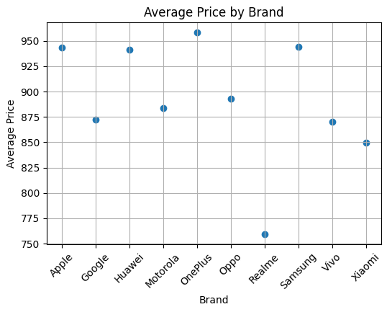
AVERAGE PRICE BY BRAND
Oneplus has the highest averageprice,indicatind it offers more premium devices in the dataset.
Apple,Samsung and Huawei also have high average prices,showing they compete in the premium segment.
Realme has the lowest average price ,suggesting ts focusing on budget friendly smartphones.
Brands like Xiaomi, Vivo, and Google fall into mid rangepricing catagory

Slide 12
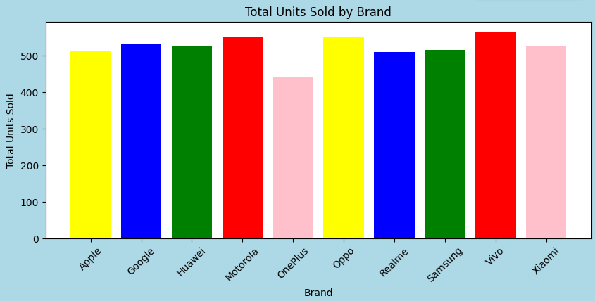
BRAND PERFORMANCE ANALYSIS
Vivo has the highest total sales, making it in the top selling brand in the data analysis.
Oppo and motorolaalso show strong sales performance, closely following the top position.
Google, Huawei, Xiaomi and samsung have moderate and consistent sales.
Oneplus has the lowest unit sold ,suggest a small market share compared to others.
Most brands fall within a similar sales range, indicating strong competion in the market.

Slide 13
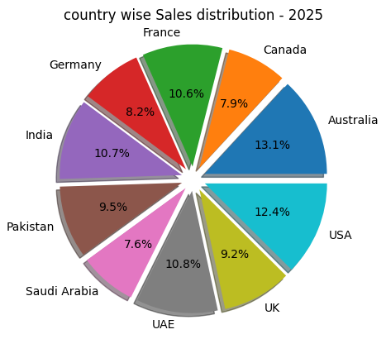
COUNTRY WISE SALES
Australia (13.1%) has the highest sales share , making it the leading market.
USA (12.4%) and india (10.7%) also contribute significantly to total sales.
UAE (10.8%) and France (10.6%) show balanced and strong performance.
UK (9.2%) and Pakistan (9.5%) have moderate contribution.
Geramany (8.2%) , Canada (7.9%) and Saudi arabia (7.6%) have the lowest shares among the listed countries.

Slide 14
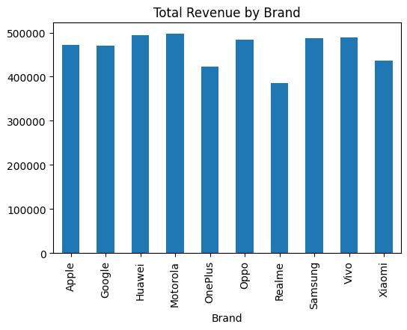
TOTAL REVENUE BY BRAND
Grouped data by Brand and summed revenue USD
Bar chart used to show distribution
In this chart apple has the highest revenue by brand.
Which takes the revenue of 4725525
Highest revenue of top5 brands are Apple, Google, Huawei, Motorola, OnePlus.

Slide 15
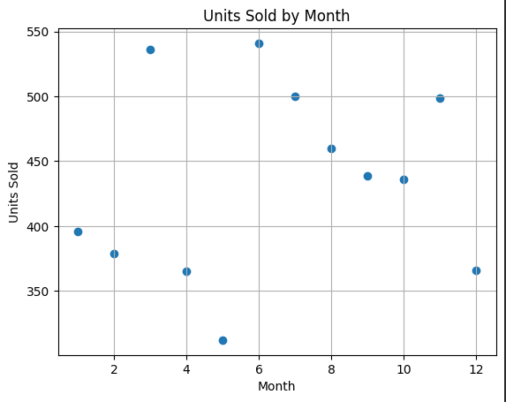
MONTHLY SALES TREND
Sales peak in month 6 (540 units) , making it in the highest permorming in the month.
Month 3 and month 11also show strong sales,close to 500 units.
The lowestsales occur in month 5 (310 units) ,indicating a significating dip.
Sales fluctuate throughout the year,showing a non linear trend.
Mid year months generally show higher sales compared to early months.
The chart highlights seasonal variation in sales performance.

Slide 16
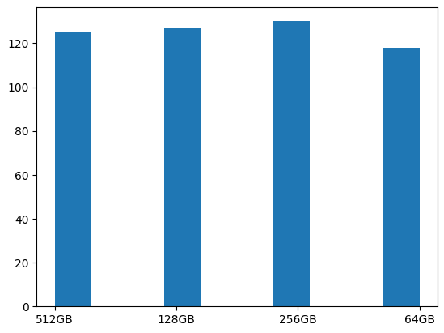
STORAGE DISTRIBUTION
256gb has the highest sales, making it the most preferred storage option.
128gb and 512gb also show strong demand, with similar sales figure.
64gb has the lowest sales, indicating lower customer preferences.
Customers seem to prefer mid to high storage variants over basic ones.
This suggests users prefer better performance and more space for apps , media, And files.
Business can focus more on 128gb and 256gb models to maximize sales.

Slide 17
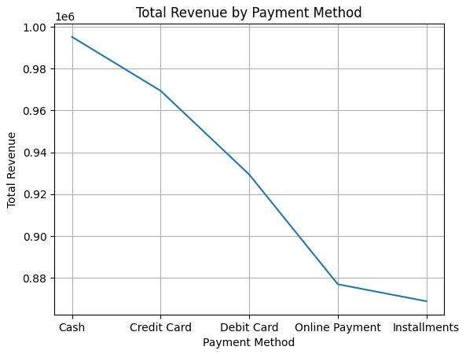
TOTAL REVENUE PAYMENT METHOD
Cash generates a highest revenue, making it the most preferred payment method.
Credit card and debit card follow, showing strong but slightly slower contributions.
Online payment shows noticeable drop in revenue compared to traditional methods.
Installments generates the lowest revenue compared o traditional methods.
Traditional payments methods like cash and cards dominate revenue, while digital and Installment options are less utilized in this dataset.

Slide 18
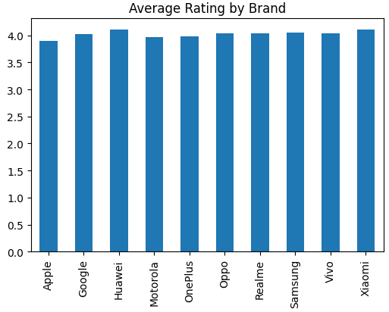
AVERAGE RATING BY BRAND
All brands have ratings close to 4, indicating generally good customer satisfaction.
Huawei and Xiaomi appear to have slightly higher ratings compared to others.
Apple has a slightly lower rating compared to the rest, but still remains to close to 4.
Brands like Samsung, Realme and Oppo show consistent and competitive ratings.
Overall, the difference in ratings among brands is very small, suggesting that most smartphones brands provide a similar level of user satisfaction.

Slide 19
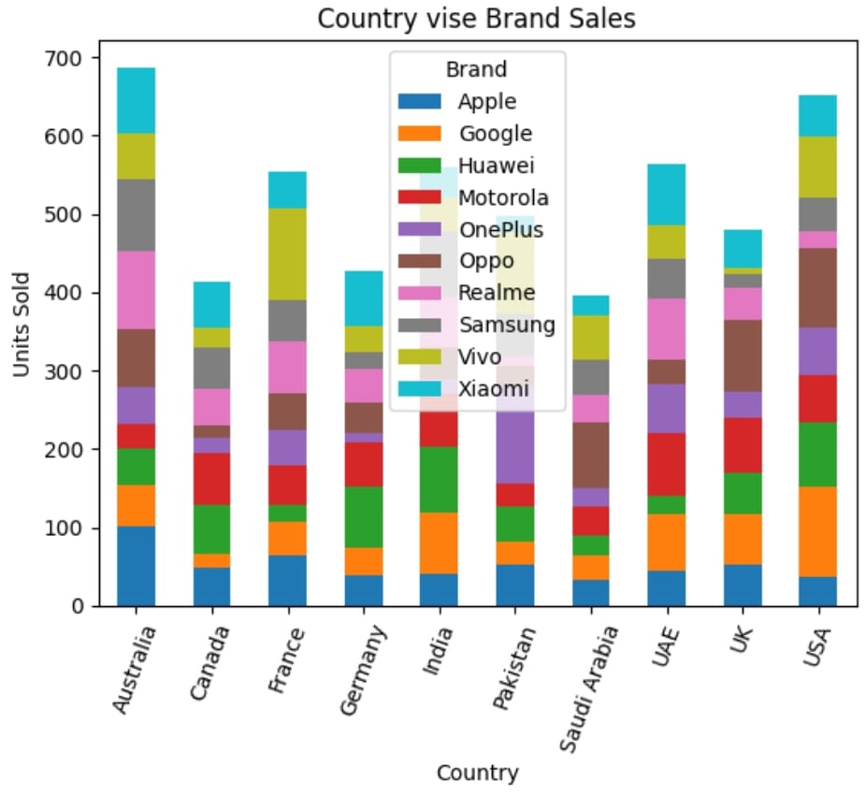
COUNTRY WISE BRAND SALES
Comparison of smartphone sales across different countries
Each bar represents a country
USA and Australia have the highest total sales
Saudi Arabia and Canada show comparatively lower sales
Apple has strong performance in Australia, USA, and UK
Samsung shows consistent sales across all countries
Xiaomi and Vivo perform well in India and Asian markets
OnePlus shows a noticeable spike in Pakistan

Slide 20
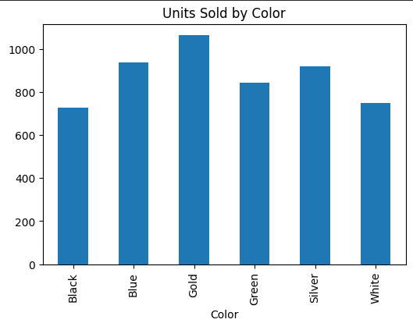
UNITS SOLD BY COLOR
Analysis of smartphone sales based on color preference
Colors included: Black, Blue, Gold, Green, Silver, White
Focus more production on Gold, Blue, and Silver models
Introduce new trendy colors to attract younger customers
Reduce inventory of low-demand colors (Black & White)

Slide 21
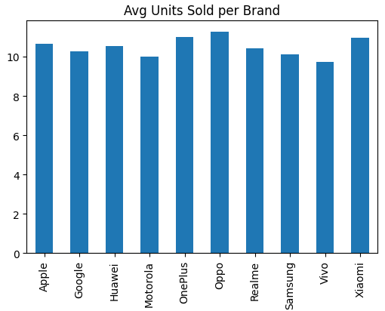
AVERAGE UNIT SOLD PER BRAND
s
Analysis of average smaetphones sales across different brands.
The different between brands is small
Indicates the competitive marketswith similar demand levels
No brand has extreme dominance.

Slide 22
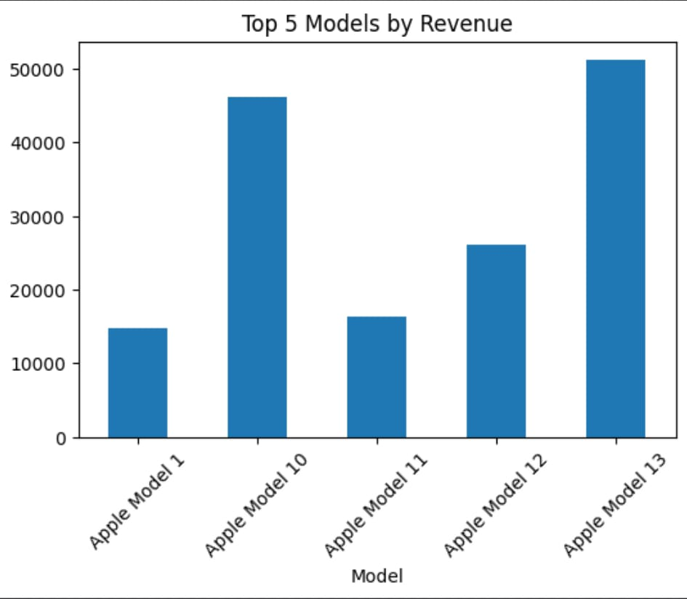
TOP 5 MODELS BY REVENUE
e
Analysis of highest revenue generating models from apple
Focus on promoting latest models (model 13)
Gradually phase out older models
Invest in innovation and upgrades to maintain growth

Slide 23
FINAL INSIGHTS :
The total revenue across all sales amounted to $1,180,314.99.
The average price per item sold was approximately $50.17.
'Apple' is the top-selling brand by unit volume (2,428 units), followed closely by 'Samsung' (2,130 units) and 'Sony' (1,939 units).
'Apple' also leads in revenue generation, contributing $226,381.18, with 'Samsung' and 'Sony' following at $205,373.91 and $185,550.84, respectively.
'Credit Card' and 'PayPal' are the most dominant payment methods, each accounting for nearly 39% of transactions, while 'Debit Card' covers about 23%.
Data analysis helps businesses understand market trends and improve decision making

Slide 24
THANK YOU

